Slide 1
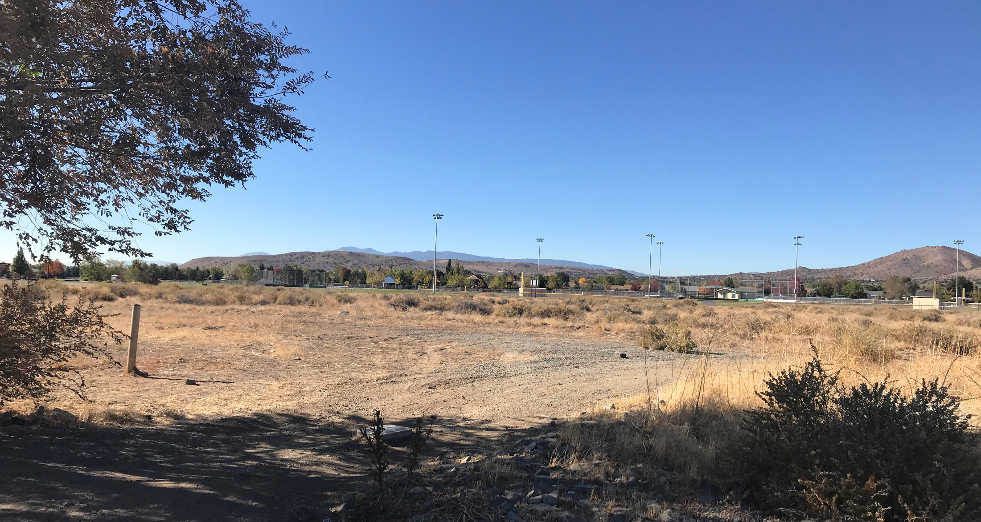
WSUP20-0019
Silverado Continuum Care Rental Community
Washoe County Board of Adjustment
December 3, 2020

Slide 2
Request
The request is for a special use permit to allow the use of Continuum of Care Facilities, Seniors, for a 157-unit continuum care rental community, in accordance with Washoe County Code (WCC) Table 110.302.05.3 for a 11.21 acres site

Slide 3
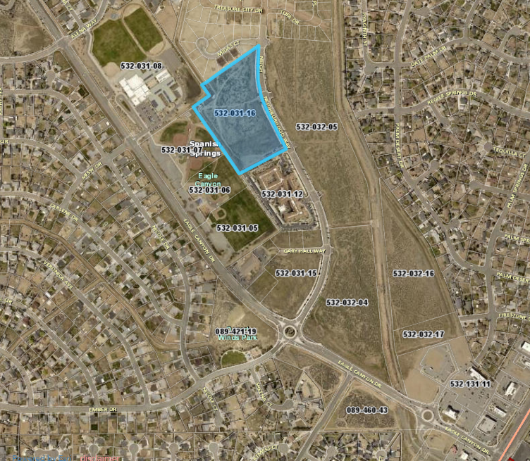

Slide 4
Background
The development will be an independent living community for seniors
The buildings are designed for age-appropriate living, with features including, zero threshold entries, wider doorways and hallways to accommodate walkers and wheelchairs, cabinetry that can be easily modified to accommodate disabilities, bathrooms designed appropriately, and motion censored lighting in appropriate locations along with fire sprinklers in all units

Slide 5
Background
The services on site include maintenance, utilities, housekeeping/linen service, meals in the clubhouse, transportation, and social amenities.
The units, clubhouse and the grounds will be professionally maintained.
There will be no assisted or memory care services at the site, however those services are available at the neighboring property to the south

Slide 6
Site Characteristics
The 11-acre site is a vacant relatively flat parcel and covered with native shrubs and grasses.
The parcel has a master plan land use designation of Commercial (C) as are the parcels to the east and south and the parcels to the west and north are designated Suburban Residential (SR).

Slide 7
Site Characteristics
The parcel’s regulatory zoning is Neighborhood Commercial (NC) as are the parcels to the east and south the parcels.
The parcels to the west are zoned Parks and Recreation (PR) and Public and Semi Public Facilities (PSP) and the parcels to the north are zoned Medium Density Suburban (MDS).

Slide 8
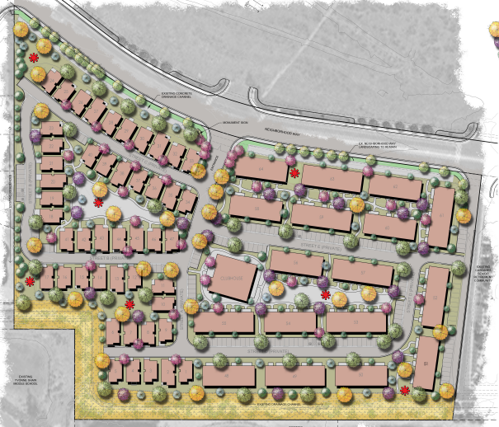
Eagle Canyon Ranch Unit 2
Cascades of the Sierras (assisted & memory care)
Shaw MS
Eagle Canyon Park

Slide 9
Analysis
The applicant says the design of the buildings will be ”warm and inviting cottage/ranch look”
There are three plans for the detached units all with one-car garages and the units ranging in size from 585 sq. ft. to 1,000 sq. ft.
There are 6 and 7-unit attached buildings and the units ranging in size from 585 sq. ft. to 855 sq. ft.

Slide 10
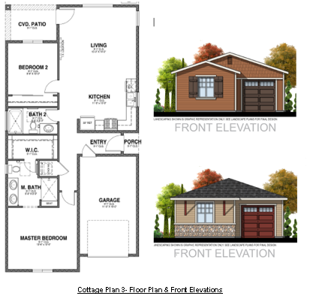
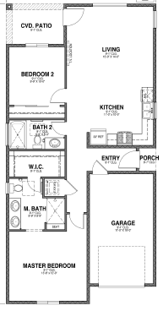

Slide 11
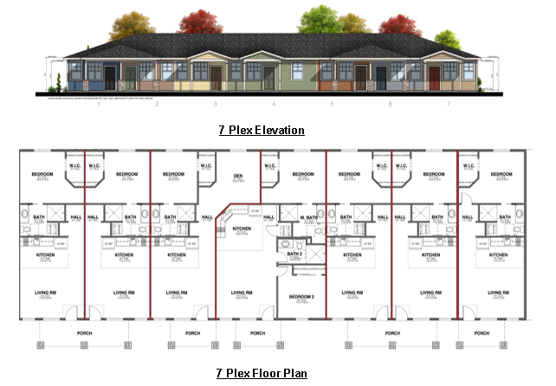
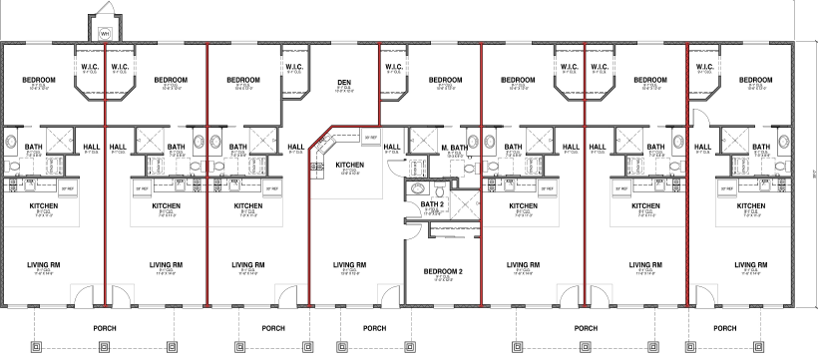

Slide 12
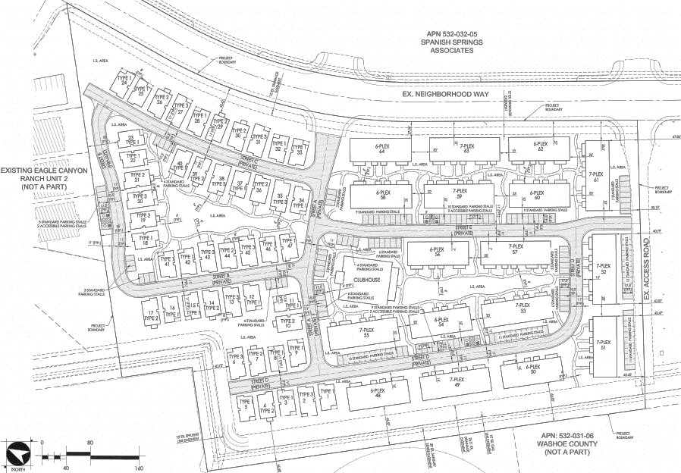

Slide 13
Analysis
The clubhouse will be located in the center of the development with a professional kitchen and dining facility for the residents.
The resident manager and rental assistant will be located in the clubhouse and social activities will be held in the clubhouse.
Other amenities on the site include a community organic garden, dog parks, bocce ball courts, lawn games, and a pedestrian trial system from the units to the clubhouse

Slide 14
Parking
The Washoe County code does not require a specific number of parking spaces for Continuum of Care Facilities, Seniors and allows the number of parking spaces to be determined during the special use permit process.
The 47 detached units will have one-car enclosed garages
An additional 145 spaces will be located throughout the community, with a total of 192 parking spaces

Slide 15
Site Access
There will be two access points to the site from Neighborhood Way, which is off Eagle Canyon Drive.
The main access is located in the middle of the site and will provide full access to the all the buildings.
Another access is located on the southern boundary of the site and will be used for emergency access.

Slide 16
Traffic
The traffic study states that the project will generate 301 average daily trips (ADT) with 10 AM peak trips and 27 PM peak trips
The study concludes that the project will have minimal impacts to the existing streets network and the network will be able to accommodate the proposed project
Typically the driving patterns associated with the use is not anticipated to impact the traffic

Slide 17
Grading
The site is relatively flat however 30,000 cubic yards of fill material will be imported to the site in order to construct the project
Per WCC 110.438.35(b)(1) a special use permit is not required for this type of grading, when a project has been reviewed and any necessary conditions can be applied to the approval of the permit

Slide 18
Public Notice & CAB
Notices were sent to 49 parcels
The Spanish Springs CAB reviewed the application on November 4, 2020, through Zoom
The CAB voted three in favor and one opposed to the approval of the permit and had the following comments:
  Good development and needed in the community
  Questions about density and traffic

Slide 19
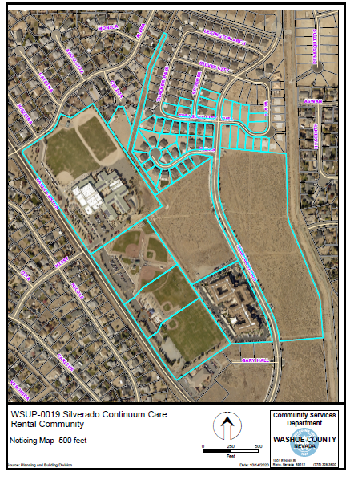

Slide 20
Reviewing Agencies
The 6 of the reviewing agencies provided conditions of approval which are included in your staff report

Slide 21
Amend Conditions of Approval
Staff is now recommending to removing condition 2h, concerning stormwater runoff flow rate after conversations with the applicant and revising condition 1e, concerning landscaping to the following:
All landscaping, irrigation and screening shall be completely installed and shall satisfy the requirements as set forth in the Washoe County Development Code prior to issuance of a Certificate of Occupancy.

Slide 22
Findings
Staff is able to make all the required findings, as detailed in the staff report on Page 14

Slide 23
Motion
I move that, after giving reasoned consideration to the information contained in the staff report and information received during the public hearing, the Washoe County Board of Adjustment approve and with the amended conditions as presented, Special Use Permit Case Number WSUP20-0019 for Silverado Homes NV Inc., having made all five findings in accordance with Washoe County Code Section 110.810.30

